Slide 1

Geometry
Unit 6, Lesson 9 Proving Triangle Similarity – Part 2 Volume 1, pg. 337

Slide 2


Benchmark
MA.912.GR.1.2
Prove triangle congruence or similarity using Side-Side-Side, Side-Angle-Side, Angle-Side-Angle, Angle-Angle-Side, Angle-Angle, and Hypotenuse Leg.
volume 1, pg. 337

Slide 3
Integrated Mathematical Thinking and Reasoning Standards
MA.K12.MTR.1.1 Actively participate in effortful learning both individually and collectively.
MA.K12.MTR.4.1 Engage in discussions that reflect on the mathematical thinking of self and others.
MA.K12.MTR.5.1 Use patterns and structure to help understand and connect mathematical concepts.
MA.K12.MTR.6.1 Assess the reasonableness of solutions.
volume 1, pg. 337

Slide 4

Learning Target
I can use triangle similarity to prove that triangles are similar.
volume 1, pg. 337

Slide 5

Warm-Up
volume 1, pg. 338

Slide 6
6.9.1 Warm-Up: Would You Rather?
In 2021, General Motors introduced the eVTOL air-taxi and the PAV (personal autonomous vehicle), a self-driving car. Both are concepts with no known timeline for production.
Do you think a drone-like personal vehicle like the eVTOL air-taxi will be reality in your lifetime?
Which would you rather have as your vehicle, an air-taxi or a self-driving car, in the future?
Explain your choice.
volume 1, pg. 338

Slide 7

Activity
volume 1, pg. 338

Slide 8

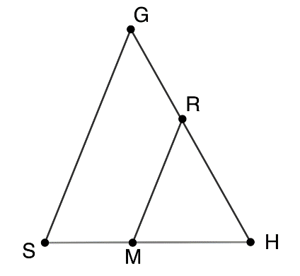
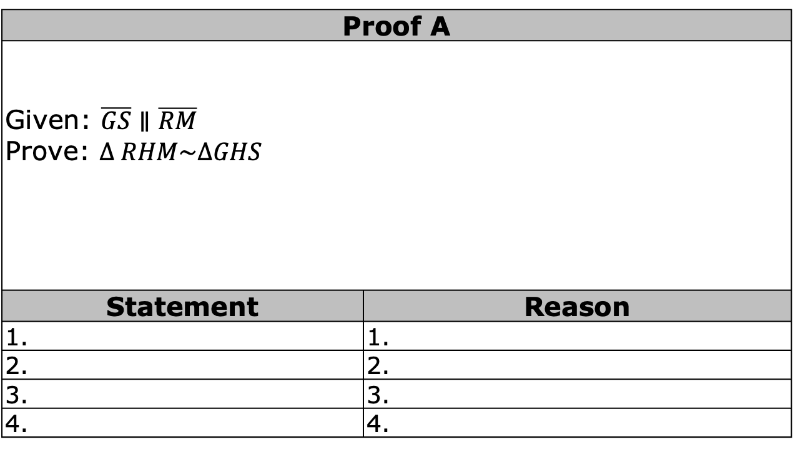
6.9.2 Activity: Proving Triangle Similarity
With your partner, sort through the statement and reason cards. Then, write each proof in the tables provided.
Proof A
Given: $\overline{GS}∥\overline{RM}$ Prove: $∆ RHM\sim ∆GHS$
Statement | Reason
1. | 1.
2. | 2.
3. | 3.
4. | 4.
volume 1, pg. 338

Slide 9
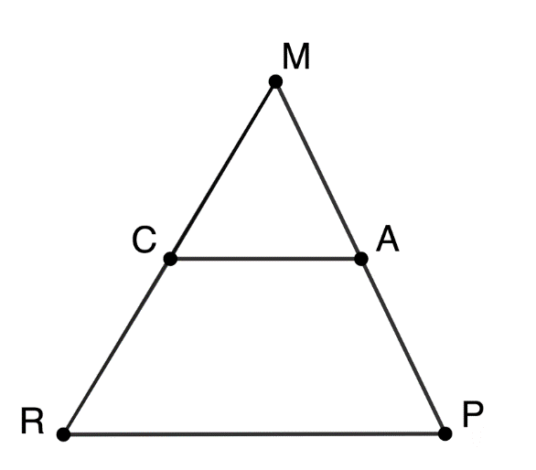
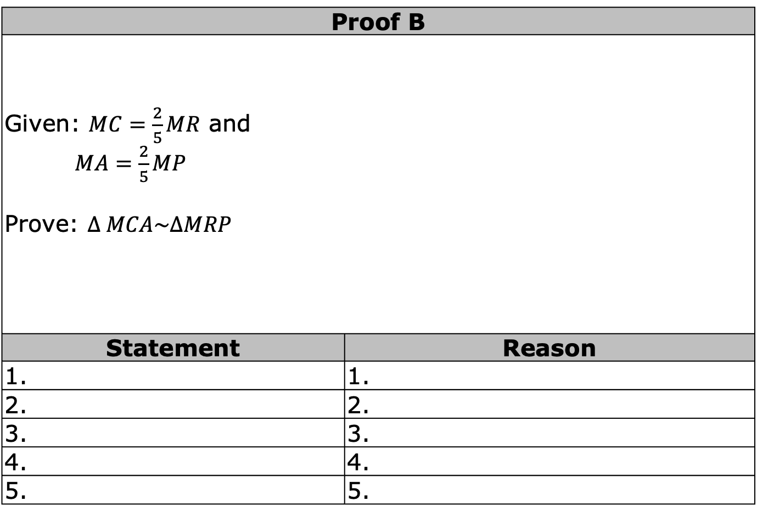
Proof B
Given: $MC=\frac{2}{5}MR$ and $MA=\frac{2}{5}MP$ Prove: $∆ MCA\sim ∆MRP$
Statement | Reason
1. | 1.
2. | 2.
3. | 3.
4. | 4.
5. | 5.
volume 1, pg. 339

Slide 10
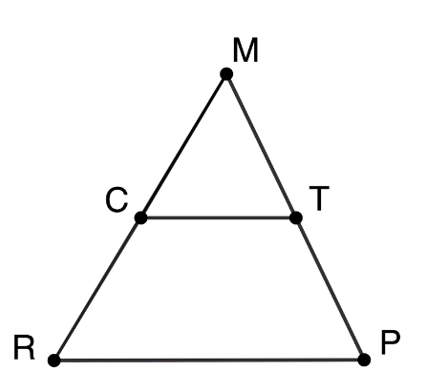
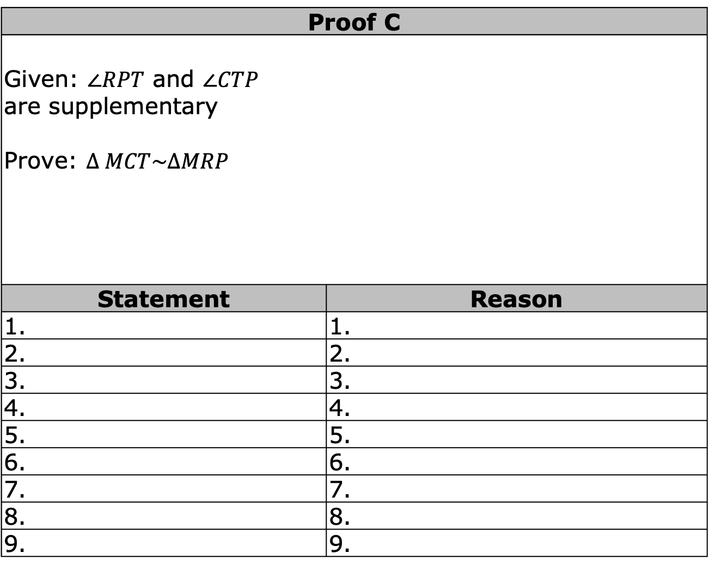
Proof C
Given: $∠RPT$ and $∠CTP$ are supplementary Prove: $∆ MCT\sim ∆MRP$
Statement | Reason
1. | 1.
2. | 2.
3. | 3.
4. | 4.
5. | 5.
6. | 6.
7. | 7.
8. | 8.
9. | 9.
volume 1, pg. 339

Slide 11
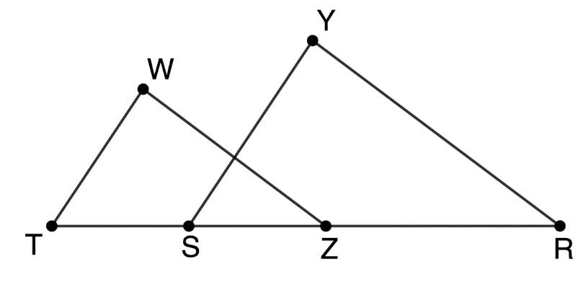
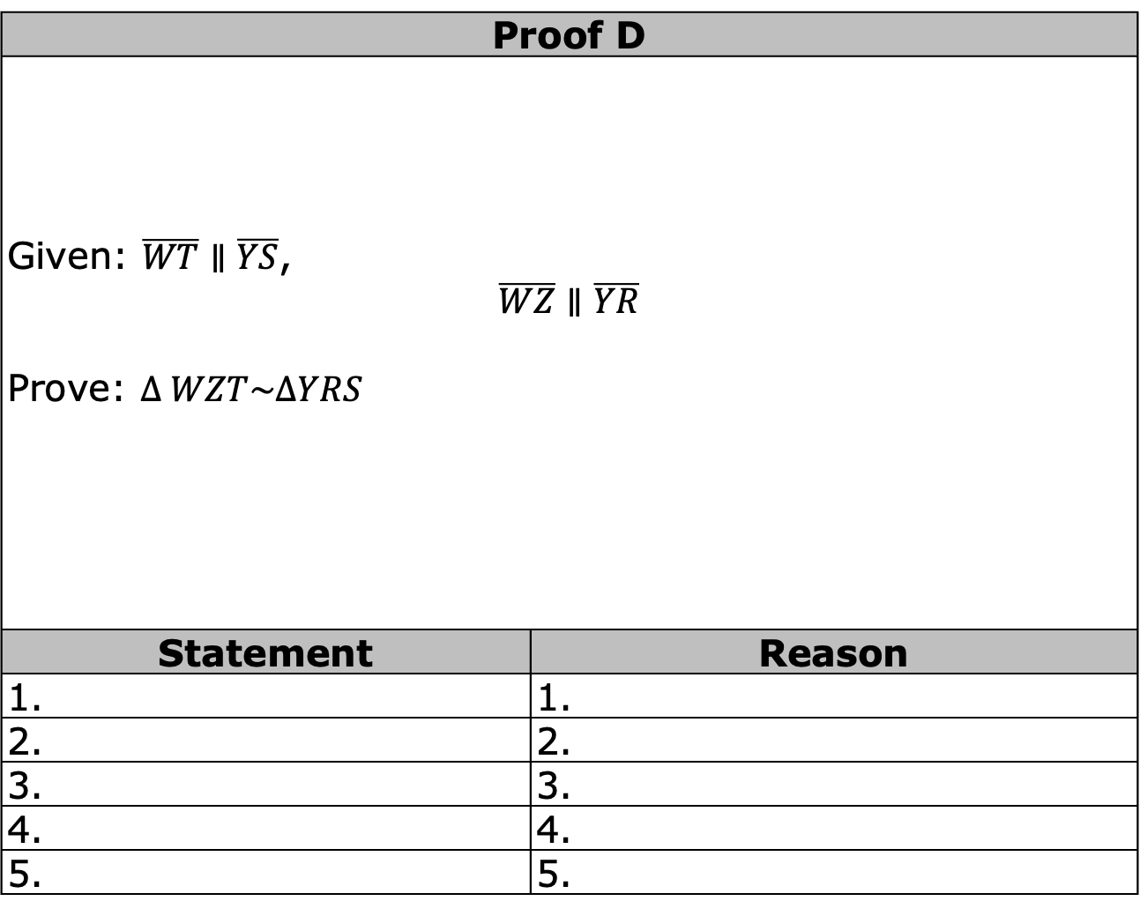
Proof D
Given: $\overline{WT}∥\overline{YS}$, $$\overline{WZ}∥\overline{YR}$$ Prove: $∆ WZT\sim ∆YRS$
Statement | Reason
1. | 1.
2. | 2.
3. | 3.
4. | 4.
5. | 5.
volume 1, pg. 340

Slide 12
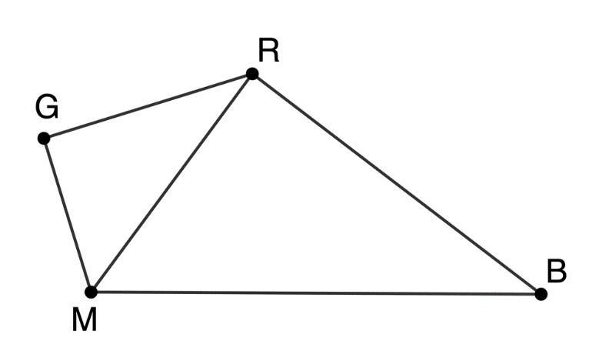
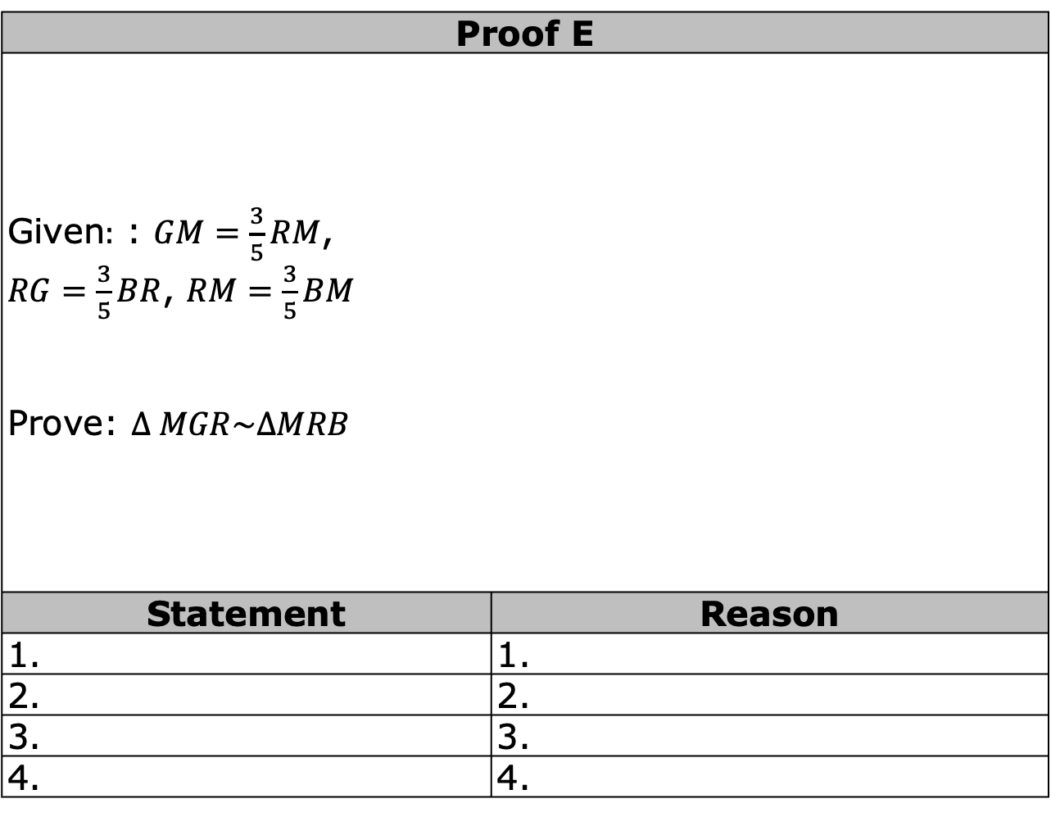
Proof E
Given$:$ : $GM=\frac{3}{5}RM$, $RG=\frac{3}{5}BR$, $RM=\frac{3}{5}BM$ Prove: $∆ MGR\sim ∆MRB$
Statement | Reason
1. | 1.
2. | 2.
3. | 3.
4. | 4.
volume 1, pg. 340

Slide 13
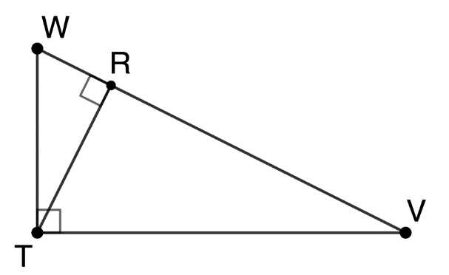
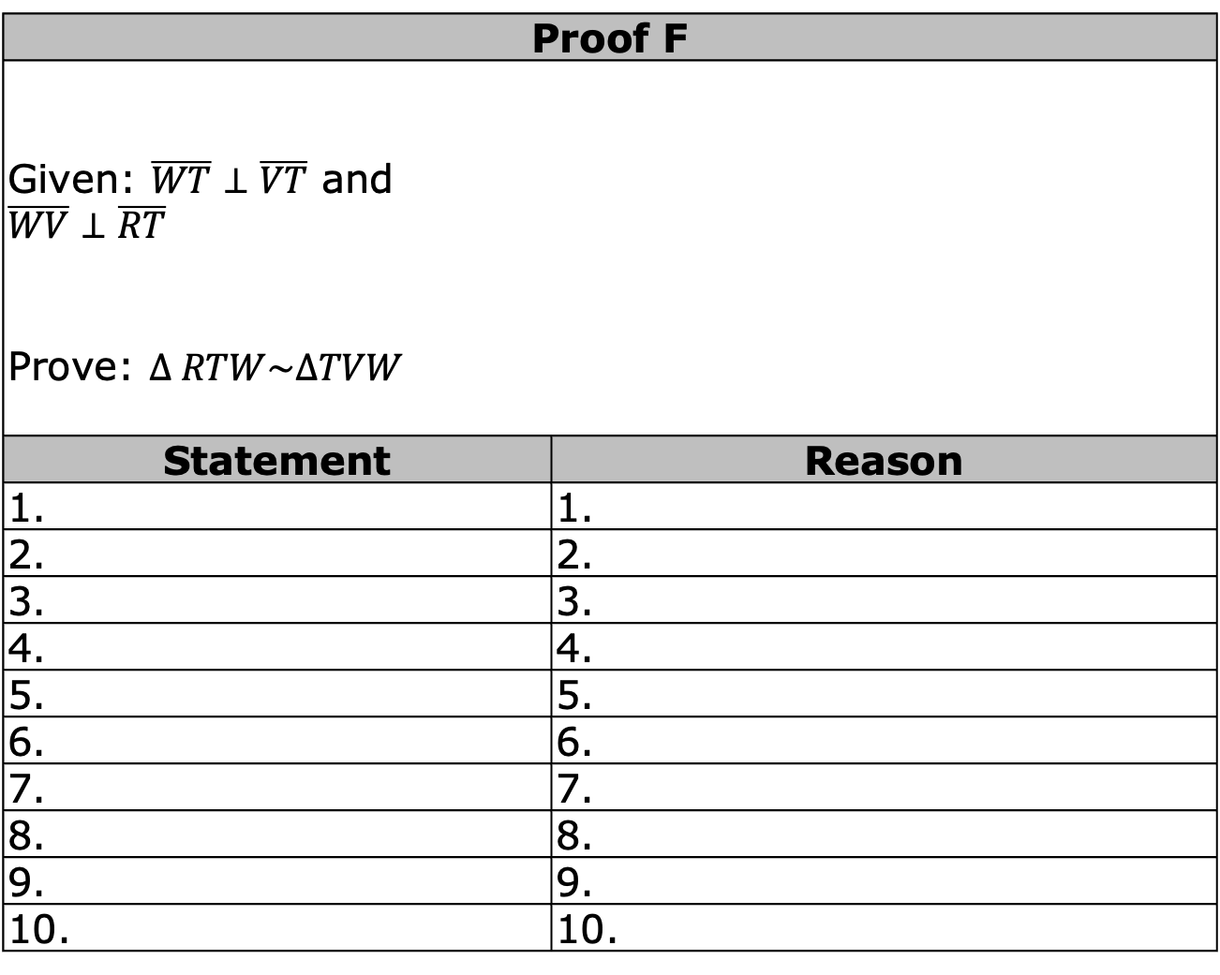
Proof F
Given: $\overline{WT}⊥\overline{VT}$ and $$\overline{WV}⊥\overline{RT}$$ Prove: $∆ RTW\sim ∆TVW$
Statement | Reason
1. | 1.
2. | 2.
3. | 3.
4. | 4.
5. | 5.
6. | 6.
7. | 7.
8. | 8.
9. | 9.
10. | 10.
volume 1, pg. 341

Slide 14
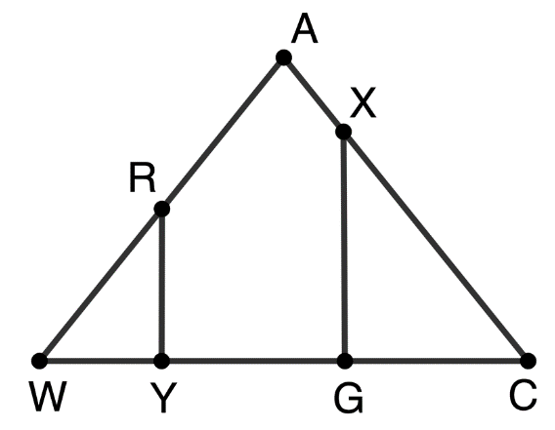
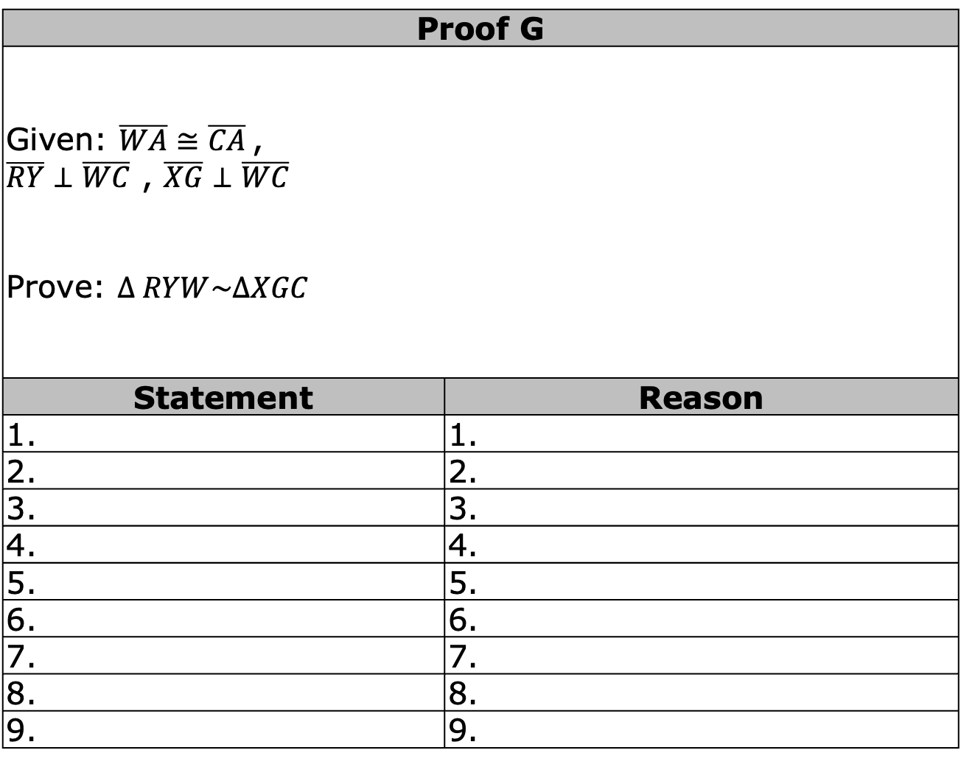
Proof G
Given: $\overline{WA}≅\overline{CA}$, $\overline{RY}⊥\overline{WC}$ , $\overline{XG}⊥\overline{WC}$ Prove: $∆ RYW\sim ∆XGC$
Statement | Reason
1. | 1.
2. | 2.
3. | 3.
4. | 4.
5. | 5.
6. | 6.
7. | 7.
8. | 8.
9. | 9.
volume 1, pg. 341

Slide 15
10. | 10.
11. | 11.
12. | 12.
13. | 13.
14. | 14.
volume 1, pg. 342

Slide 16

Wrap-Up
volume 1, pg. 342

Slide 17
6.9.3 Wrap-Up: Cool Down
Write an explanation to a classmate who might have missed today’s lesson, in your own words, about proving triangle similarity.
volume 1, pg. 342

